Slide 1
컴퓨터 네트워크 Computer Networks and Internets, 6e

Slide 2
PPTs are from lecture slides of
Computer Networks and Internets, 6th Ed. by Douglas E. Comer, Pearson

Slide 3
Chapter 8 Reliability and Channel Coding

Slide 4
8.1 Introduction
This chapter
continues the discussion by examining errors that can occur during transmission and techniques that can be used to control errors
The concepts presented here
are fundamental to computer networking
and are used in communication protocols at many layers of the stack

Slide 5
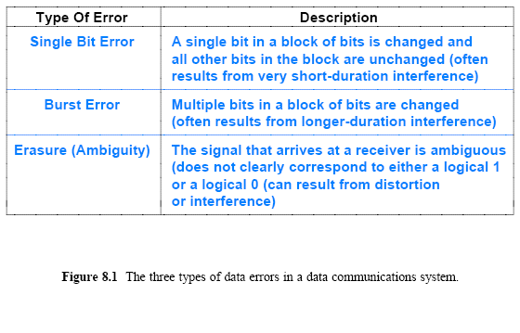
8.3 Effect of Transmission Errors on Data

Slide 6
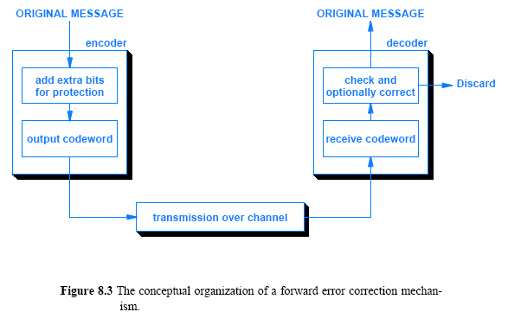
Handling Channel Errors

Slide 7
8.6 An Example Block Error Code: Single Parity Checking
How can additional information be used to detect errors?
consider a single parity checking (SPC) mechanism
One form of SPC defines a block to be an 8-bit unit of data (i.e., a single byte)
On the sending side, an encoder adds an extra bit, called a parity bit, to each byte before transmission
A receiver uses parity bit to check whether bits in the byte are correct
Before parity can be used, the sender and receiver must be configured for either even parity or odd parity
Figure 8.4 lists examples of data bytes and the value of the parity bit that is sent when using even or odd parity

Slide 8
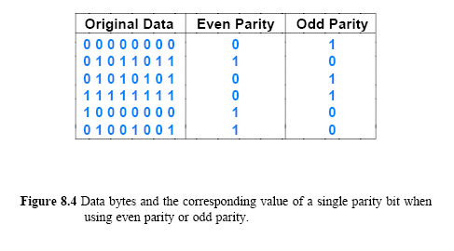
8.6 An Example Block Error Code: Single Parity Checking

Slide 9
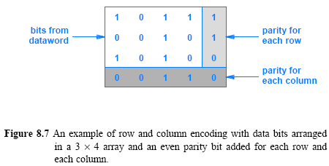
8.11 Error Correction with Row and Column (RAC) Parity
Imagine an array of 3-rows and 4-columns, with a parity bit added for each row and for each column
Figure 8.7 illustrates the arrangement, which is known as a Row and Column (RAC) code
Example RAC has n= 20, which means that it is a (20, 12) code

Slide 10
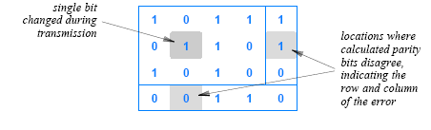
8.11 Error Correction with Row and Column (RAC) Parity
How error correction works? Assume that one of the bits in Figure 8.7 (below) is changed during transmission:
When the receiver arranges the bits into an array and parity bits are recalculated
two of the calculations will disagree with the parity bits received, as Figure 8.8 illustrates
a single bit error will cause two calculated parity bits to disagree with the parity bit received

Slide 11
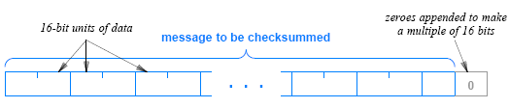
8.12 The 16-Bit Checksum Used in the Internet
A particular coding scheme plays a key role in the Internet
Known as the Internet checksum, the code consists of a 16-bit 1s complement checksum
The Internet checksum does not impose a fixed size on a dataword
the algorithm allows a message to be arbitrarily long
and computes a checksum over the entire message
The Internet checksum treats data in a message as a series of 16-bit integers, as Figure 8.9 below illustrates

Slide 12
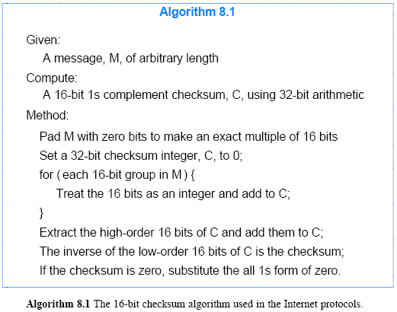
8.12 The 16-Bit Checksum Used in the Internet

Slide 13
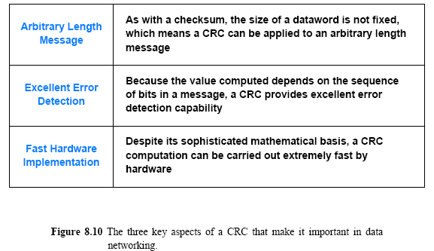
8.13 Cyclic Redundancy Codes (CRC)
A form of channel coding known as a Cyclic Redundancy Code (CRC) is used in high-speed data networks
Key properties of CRC are summarized below

Slide 14
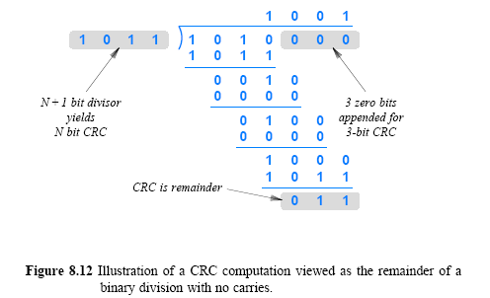
8.13 Cyclic Redundancy Codes (CRC)

Slide 15
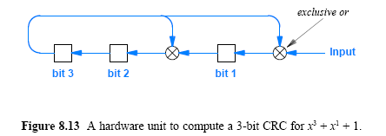
8.14 An Efficient Hardware Implementation of CRC
CRC hardware is arranged as a shift register with exclusive or (xor) gates between some of the bits
Figure 8.13 illustrates the hardware needed for the 3-bit CRC computation from Figure 8.12

Slide 16
Chapter 9 Transmission Modes
© Pearson Education Inc., Upper Saddle River, NJ. All rights reserved.
15
Notes:
16

Slide 17
9.1 Introduction
This chapter
continues the discussion by focusing on the ways data is transmitted
introduces common terminology
explains the advantages and disadvantages of parallelism
discusses the important concepts of synchronous and asynchronous communication
© Pearson Education Inc., Upper Saddle River, NJ. All rights reserved.
16
Notes:
17

Slide 18
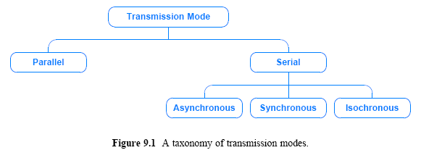
9.2 A Taxonomy of Transmission Modes
We use the term transmission mode to refer to the manner in which data is sent over the underlying medium
© Pearson Education Inc., Upper Saddle River, NJ. All rights reserved.
17
Notes:
18

Slide 19
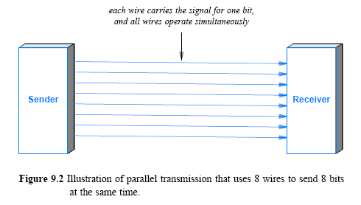
9.3 Parallel Transmission
© Pearson Education Inc., Upper Saddle River, NJ. All rights reserved.
18
Notes:
19

Slide 20
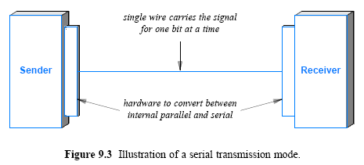
9.4 Serial Transmission
© Pearson Education Inc., Upper Saddle River, NJ. All rights reserved.
19
Notes:
20

Slide 21
9.7 Asynchronous Transmission
It is asynchronous if the system allows the physical medium to be idle for an arbitrary time between two transmissions
The asynchronous style of communication is well-suited to applications that generate data at random
(e.g., a user typing on a keyboard or a user that clicks on a link)
The disadvantage of asynchrony arises from the lack of coordination between sender and receiver
Asynchronous technologies usually arrange for a sender to transmit a few extra bits before each data item
to inform the receiver that a data transfer is starting
extra bits allow the receiver to synchronize with the incoming signal
the extra bits are known as a preamble or start bits
© Pearson Education Inc., Upper Saddle River, NJ. All rights reserved.
20
Notes:
21

Slide 22
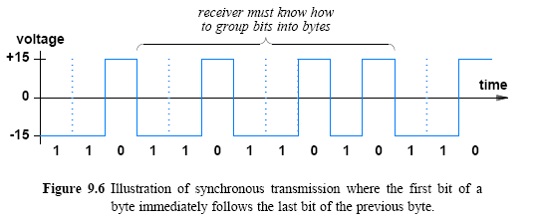
9.9 Synchronous Transmission
© Pearson Education Inc., Upper Saddle River, NJ. All rights reserved.
21
Notes:
22

Slide 23
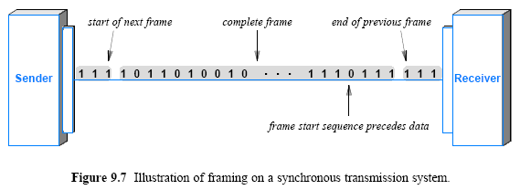
9.10 Bytes, Blocks, and Frames
© Pearson Education Inc., Upper Saddle River, NJ. All rights reserved.
22
Notes:
23

Slide 24
9.11 Isochronous Transmission
Isochronous transmission
is designed to provide steady bit flow for multimedia applications
Delivering such data at a steady rate is essential
because variations in delay known as jitter can disrupt reception (cause pops or clicks in audio/make video freeze for a short time)
Isochronous network is designed to accept and send data at a fixed rate, R
Network interface is such that data must be handed to the network for transmission at exactly R bits per second
For example, an isochronous mechanism designed to transfer voice operates at a rate of 64,000 bits per second
A sender must generate digitized audio continuously
A receiver must be able to accept and play the stream
© Pearson Education Inc., Upper Saddle River, NJ. All rights reserved.
23
Notes:
24

Slide 25
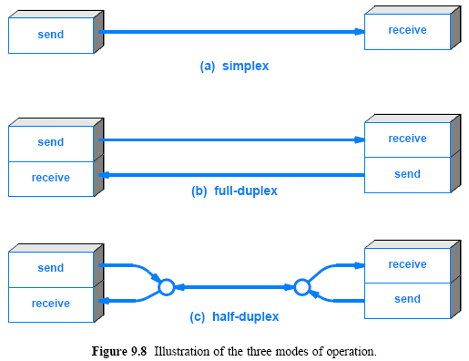
9.12 Simplex, Half-Duplex, and Full-Duplex Transmission
© Pearson Education Inc., Upper Saddle River, NJ. All rights reserved.
24
Notes:
25

Slide 26
Chapter 10 Modulation and Modems
© Pearson Education Inc., Upper Saddle River, NJ. All rights reserved.
25
Notes:
26

Slide 27
10.1 Introduction
This chapter
focuses on the use of high-frequency signals to carry information
discusses how information is used to change a high-frequency electromagnetic wave
explains why the technique is important
describes how analog and digital inputs are used
© Pearson Education Inc., Upper Saddle River, NJ. All rights reserved.
26
Notes:
27

Slide 28
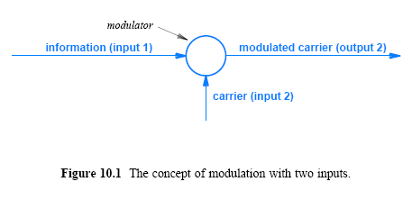
10.3 Analog Modulation Schemes
© Pearson Education Inc., Upper Saddle River, NJ. All rights reserved.
27
Notes:
28

Slide 29
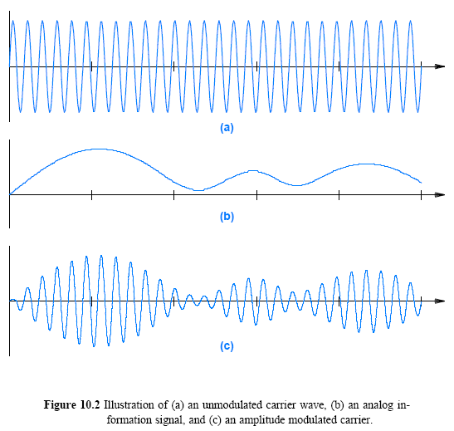
10.4 Amplitude Modulation
© Pearson Education Inc., Upper Saddle River, NJ. All rights reserved.
28
Notes:
29

Slide 30
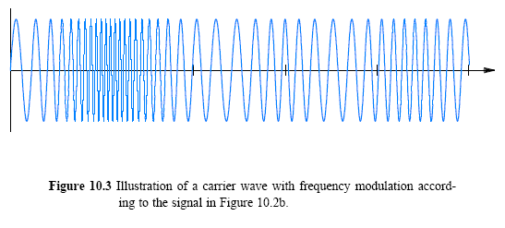
10.5 Frequency Modulation
© Pearson Education Inc., Upper Saddle River, NJ. All rights reserved.
29
Notes:
30

Slide 31
10.6 Phase Modulation (PM)
One of the properties of a sine wave is its phase, the offset from a reference time at which the sine wave begins
It is possible to use changes in phase to represent a signal
We use the term phase shift to characterize such changes
If phase changes after cycle k, the next sine wave will start slightly later than the time at which cycle k completes
A slight delay resembles a change in frequency
PM can be thought of as a special form of frequency modulation
However, phase shifts are important when a digital signal is used to modulate a carrier
© Pearson Education Inc., Upper Saddle River, NJ. All rights reserved.
30
Notes:
31

Slide 32
10.8 Modulation, Digital Input, and Shift Keying
How can digital input be used in modulation?
Modifications to the modulation schemes described above are needed:
instead of modulation that is proportional to a continuous signal, digital schemes use discrete values
To distinguish between analog and digital modulation
we use the term shift keying rather than modulation
Shift keying operates similar to analog modulation
instead of a continuum of possible values, digital shift keying has a fixed set
for example, AM allows the amplitude of a carrier to vary by arbitrarily small amounts in response to a change in the signal
in contrast, amplitude shift keying uses a fixed set of possible amplitudes
Figure 10.4 illustrates concept for ASK and FSK
© Pearson Education Inc., Upper Saddle River, NJ. All rights reserved.
31
Notes:
32

Slide 33
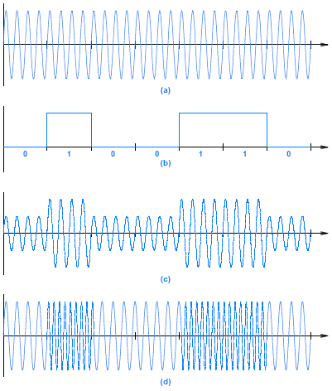
Figure 10.4 Illustration of
a carrier wave
a digital input signal
amplitude shift keying
frequency shift keying
© Pearson Education Inc., Upper Saddle River, NJ. All rights reserved.
32
Notes:
33

Slide 34
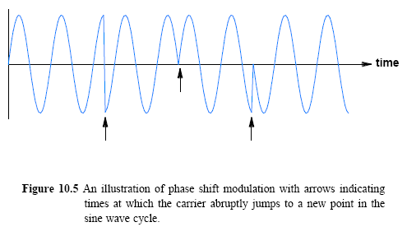
10.9 Phase Shift Keying (PSK)
Figure 10.5 illustrates how phase shifts affects a sine wave
There are three (abrupt) phase changes
A phase shift is measured by the angle of the change
The left most portion of sine wave changes its phase by π/2 radians or 180
The second phase change corresponds to a 180 shift
© Pearson Education Inc., Upper Saddle River, NJ. All rights reserved.
33
Notes:
34

Slide 35
Assignment
1. How CRC and checksum are produced in the real protocol?
Why is CRC located at the tail of the packet?
Why is Checksum located at the header of the packet?
2. What can a RAC scheme achieve that a single parity bit scheme cannot?
Send your results to me by email. (Due date: 4.5. )
This assignment will be used to check your attendance.

